Slide 1

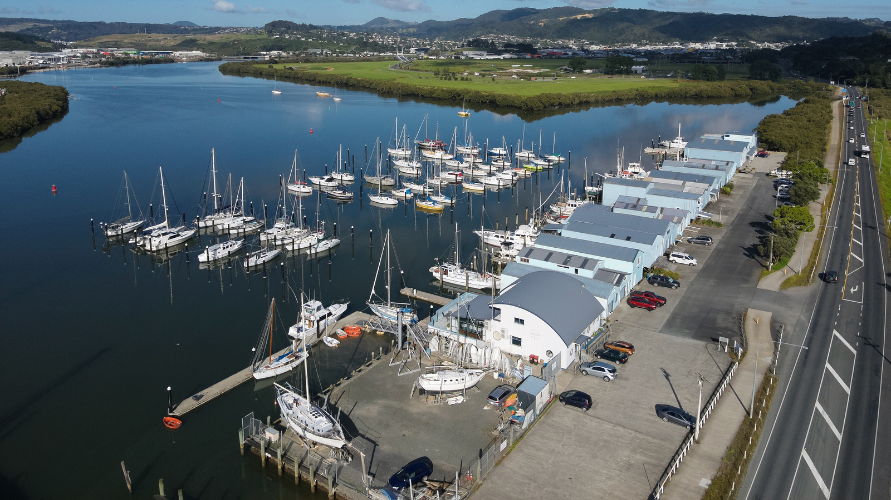

20
26
VENUE HIRE
Kissing Point Clubrooms are available for hire for a wide range of events, such as celebrations, birthdays, anniversaries, reunions, weddings, memorials, conferences, and meetings.

Slide 2
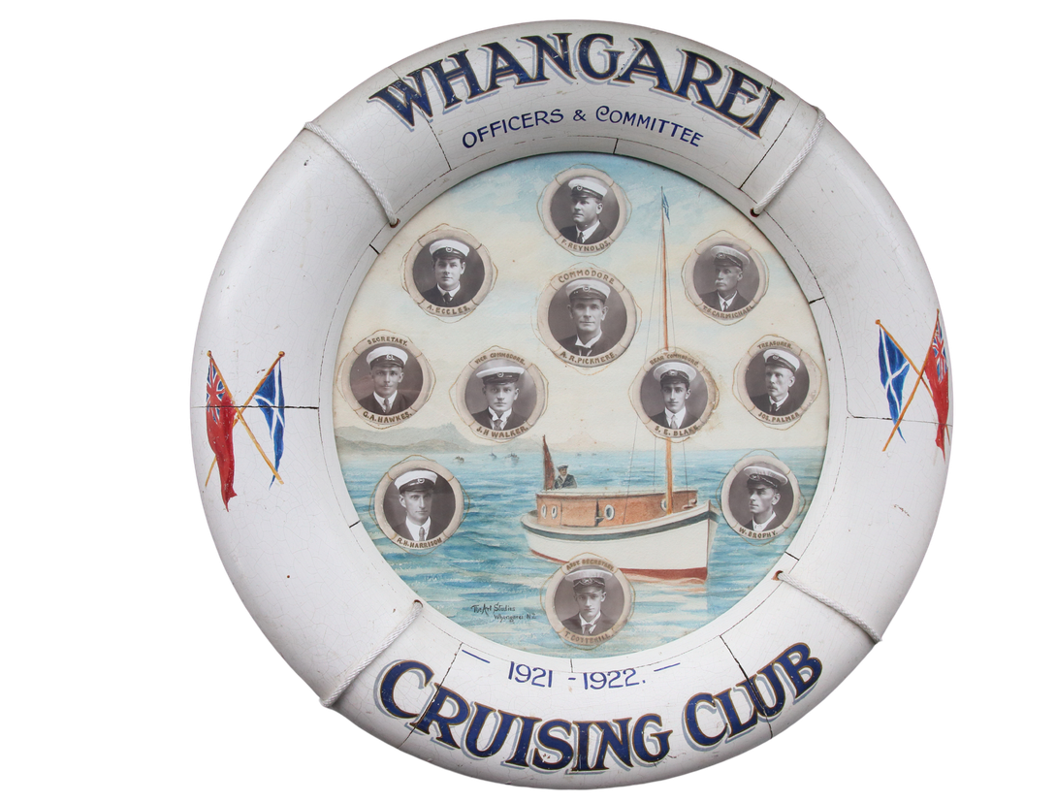
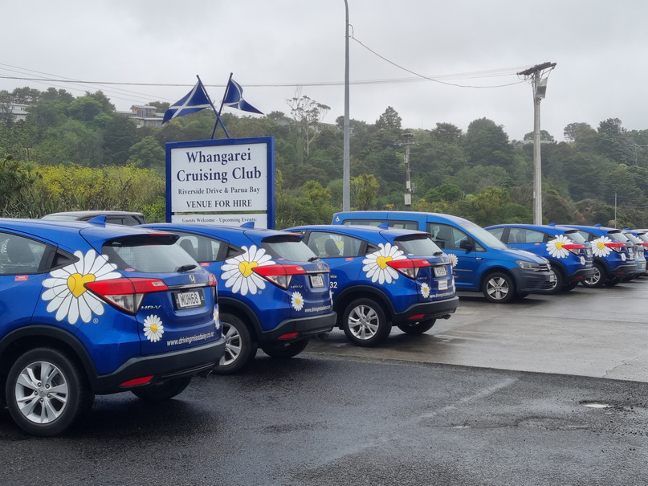
ABOUT
1921 - 2026
US
Whangarei Cruising Club is a
yacht club with a rich history
that boasts two clubrooms.
Parua Bay is where we do
most of our sailing and our main clubrooms at Kissing Point is centrally located at 212 Riverside Drive. There is plenty of parking right outside and accessible to all.
We offer Kissing Point’s clubrooms for private events and business meetings and conferences plus several community groups meet at the clubrooms with a regular weekly or monthly booking.
Driving Miss Daisy
hold their monthly meetings
at Kissing Point

Slide 3
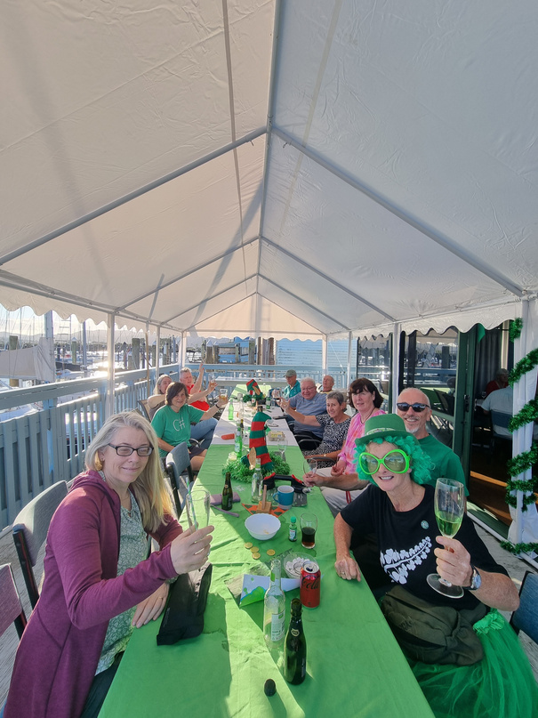
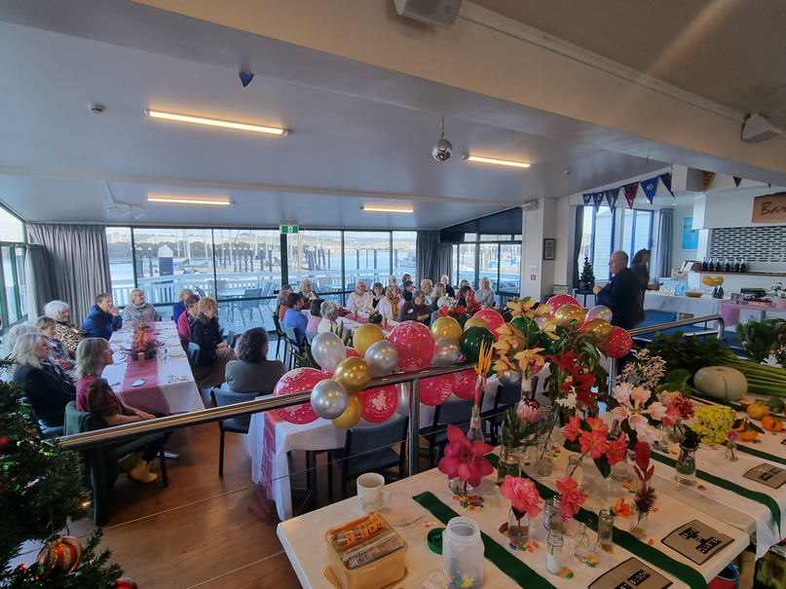
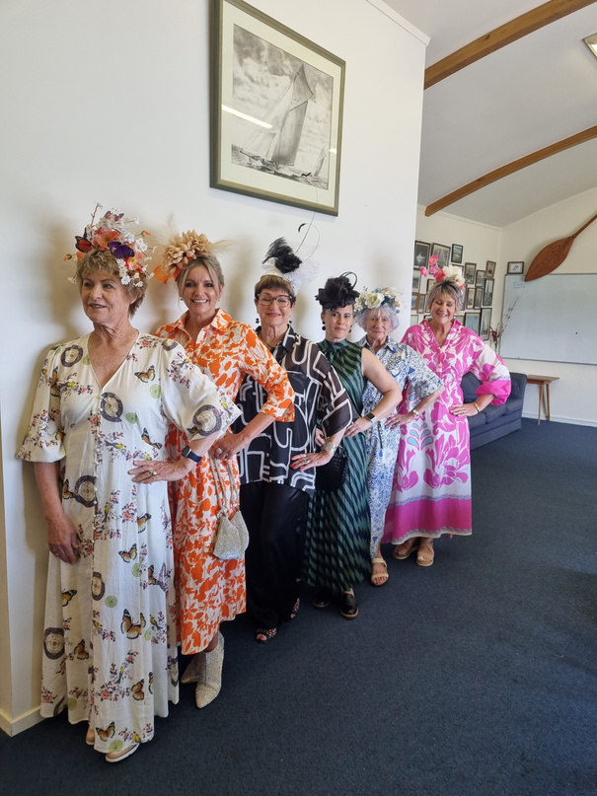
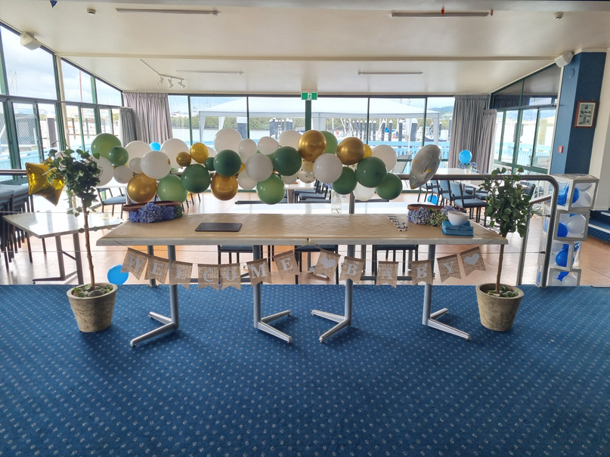
STYLE IT
YOUR WAY
Parua Bay Garden Club
Fashion Parade
Melbourne
Cup Day
Baby Gender
Reveal

Slide 4
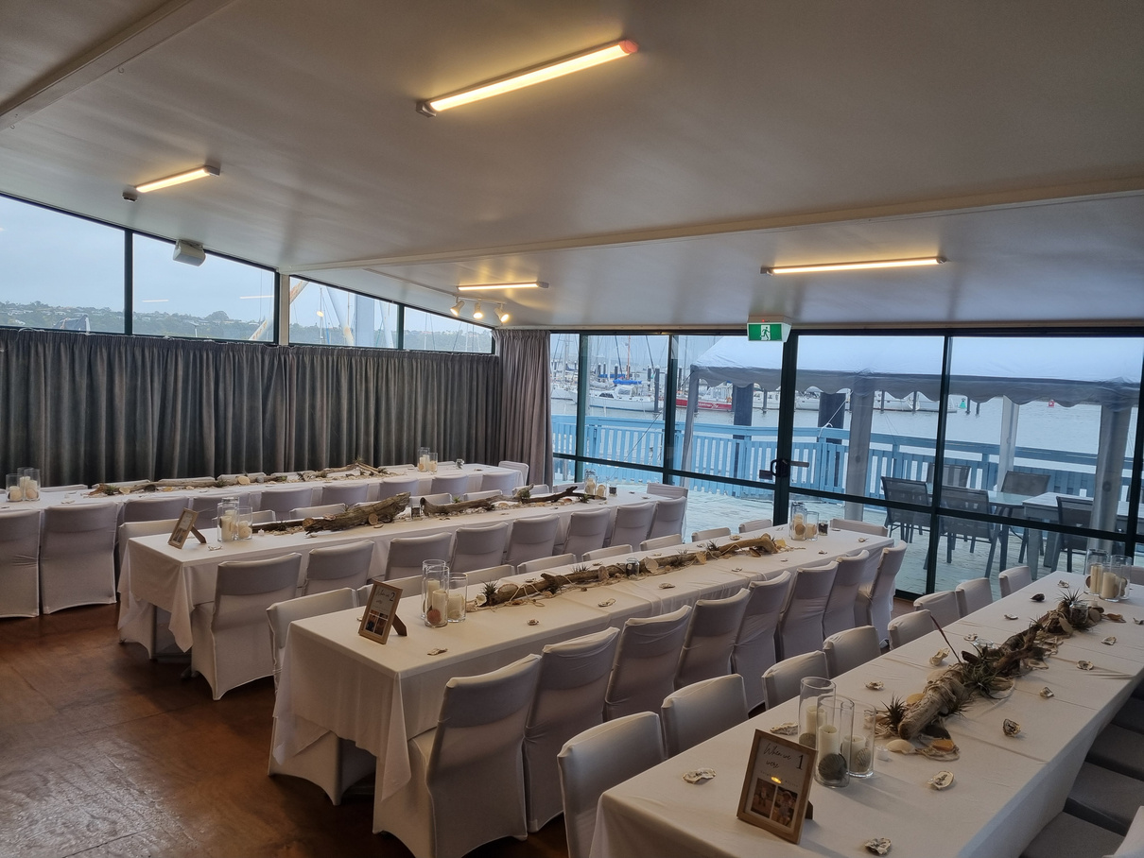
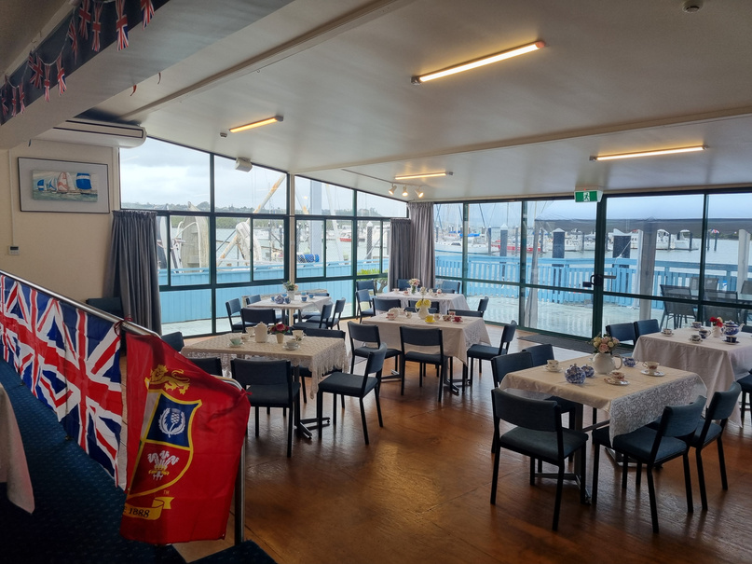
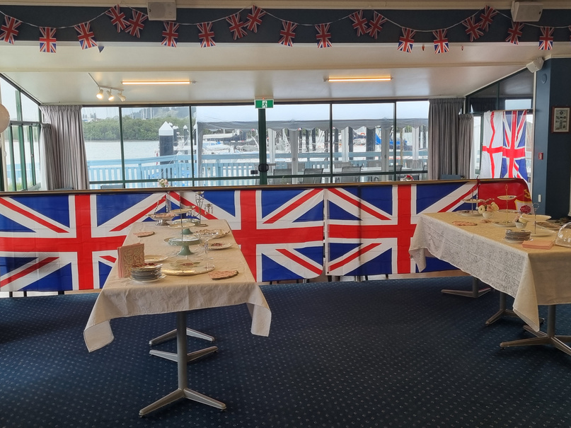
OUR
Main Lounge
VENUE
The main downstairs area is perfect for hosting weddings, birthday parties, memorials, Christmas gatherings, and business conferences. It features a spacious lounge, bar, galley, and a deck with stunning water views.
  Hire Options:
    Half-day rental: $250 for up to four hours
    Full-day rental: $500 for up to eight hours
    Additional options can be arranged
A full bar service is available for $150 during the first four hours, which includes one bartender. If your event exceeds 60 guests, a second bartender will be required.
Enhance your event with a large-screen TV and a surround sound audio system that connects via Bluetooth, providing excellent audio and visual experiences.
Total capacity of 100 guests.

Slide 5
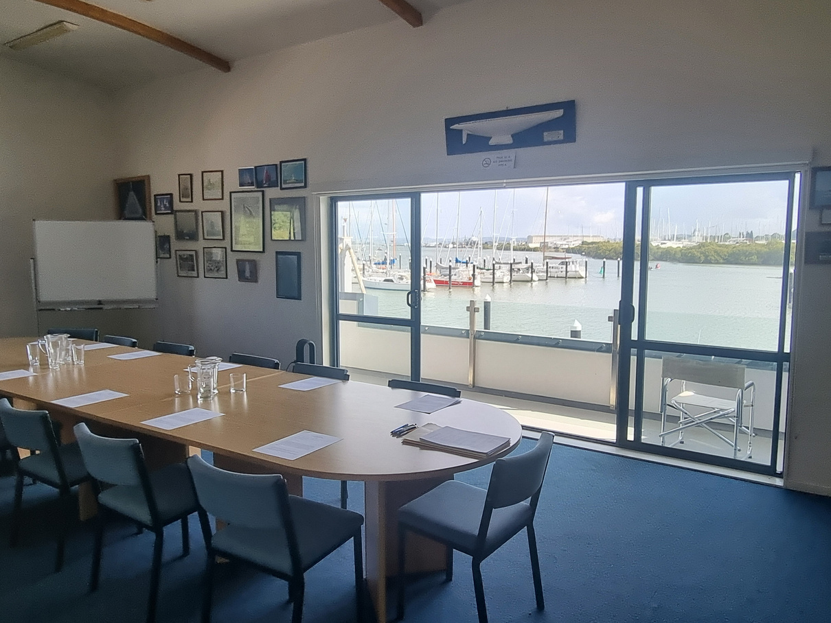
WILKINSON
MEETING ROOM
Perfect for business meetings, presentations, community gatherings, and networking events.
Located upstairs with sliding doors opening to fabulous views over the Marina with a balconette.
Available for half-day or full-day rentals, as well as multi-day bookings.
Includes a kitchenette and restroom facilities with a full bathroom located downstairs.
Equipped with a TV screen, a large whiteboard, and a portable whiteboard.
Accommodates up to 30 people seated.
Pricing
Full Day Rental - $250
Half Day Rental - $150
Two Hours or Less - $50
Please be aware that this meeting room is situated on the upper floor with stair access only
Catering options are available to meet your needs through our Club Caterer.

Slide 6
OUR
FEEDBACK
Kia ora
We enjoyed our Christmas lunch at the Cruising Club last year so much we would really love to hire it again!
Whangarei Principals Assoc.
Thank you so much for everything that you have done to organise my eightieth birthday and make things run so smoothly. I cannot thank you enough for your efforts.
You were extremely professional and helpful during our run up to the party. Thank you again,
Dave and Arlene
We had such a good night, Heather on the bar was amazing and it was so lovely. Thank you so much for everything.
Dec 21
50th Birthday
Hahuiao
“Booking the Whangarei Cruising Club was an absolute breeze.
Clare was extremely accommodating, we loved the flexibility of being able to decorate the room exactly as we wanted.
With its beautiful surroundings, spacious clean facilities, and ample parking. Being a short drive from both the Whangārei township and Onerahi airport made it stress free for our wedding guests to access the club.
Views of the harbour were amazing regardless of the weather. Our event was held during a cyclone : )
Bar staff were exceptionally polite and courteous. The cruising club Chef Bridget prepared the most delicious salads, our overseas guests couldn’t stop raving about. We would highly recommend."
Thank you for all your assistance! 🤗
Leighton and Alyssa

Slide 7


Introducing Averil and Shannon Parker of Cape Catering, who are our resident Club Caterers.
Averil specialises in creating personalised menus to suit your occasion, requirements, and budget.
From relaxed gatherings to larger celebrations, Cape Catering can help make your event both memorable and stress free.
Cape Catering offers a wide range of catering options, from delicious finger foods and platters to full buffet meals.
Finger foods and platters are a great choice for memorials, parties, corporate functions, and informal celebrations.
We’re happy to provide a range of menu options for you to browse through, followed by a chat with Averil to help design the perfect menu for your special event.

Slide 8

CONTACT
INFORMATION
Every event is unique and we welcome the opportunity to discuss your special requirements and how we can help to make your occasion truly memorable.
Contact us and let’s have a chat.
Get In Touch
027 257 1273
09 438 9043
wcchq1@gmail.com
www.wcc.net.nz
212 Riverside Drive, Parahaki, Whangarei

